Slide 1
Variable Voltage RV Pumps
Taylor Lilac
Regional Sales Manager

Slide 2
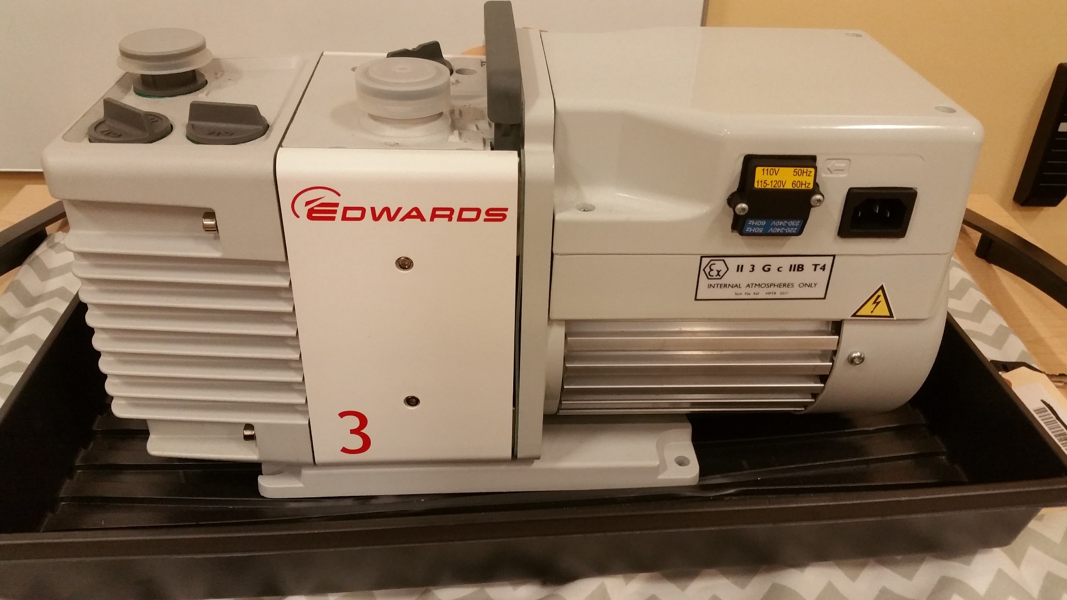
Side View

Slide 3
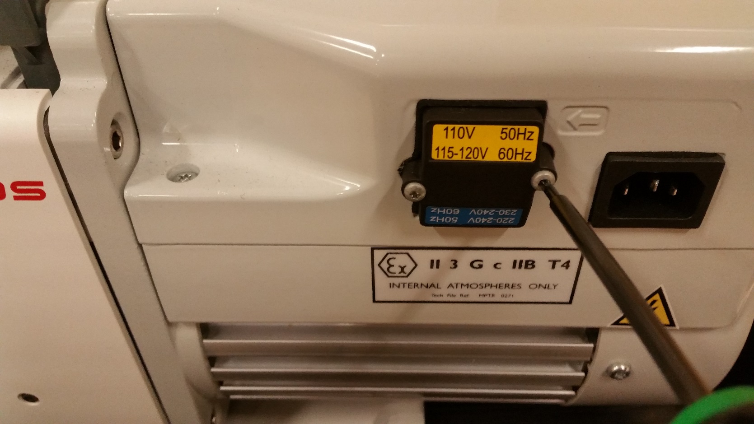
Step One
Unplug Pump
With a T-10 Screwdriver or bit, remove the voltage cap

Slide 4
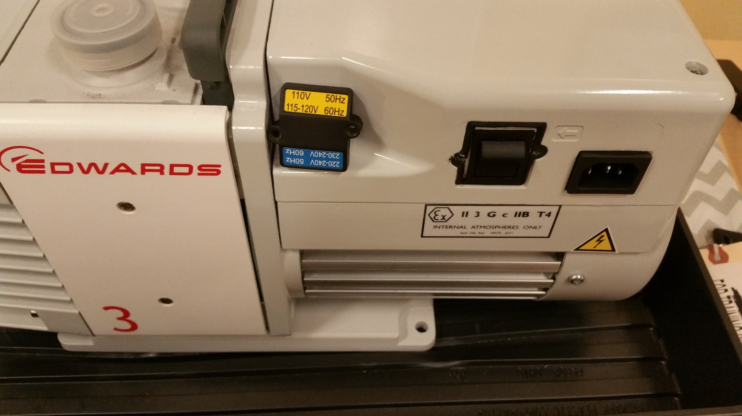
Step Two
Flip the switch to select desired voltage

Slide 5
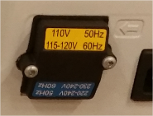
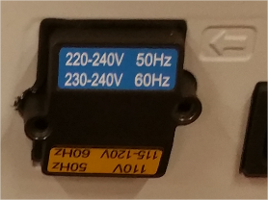
Step 3
Screw the voltage cap back on with desired voltage reading on the top.
There is a fail-safe on the cap that will not let you secure it over the switch with an incorrect voltage setting.
Set For 115V Set For 230V

Slide 6

Step 4
Plug in your pump. You are now ready turn it on and begin pumping.

